Slide 1
Distributions From Distributions
Understanding statistical tests
Two Sample t tests
Relation to Linear Regression

Slide 2
So far we’ve seen
That we can use brute force available to us today with computers to create normal distributions and perform analyses directly on the data to create null distributions.
We can then use the null distributions to determine the significance of certain statistics
But we’ve only consider “single sample” approaches. Let’s go on to 2 sample problems, which are sometimes easier to appreciate.

Slide 3
What does single sample t test ask?
Does my data come from a population that is normal with a mean of μ

Slide 4
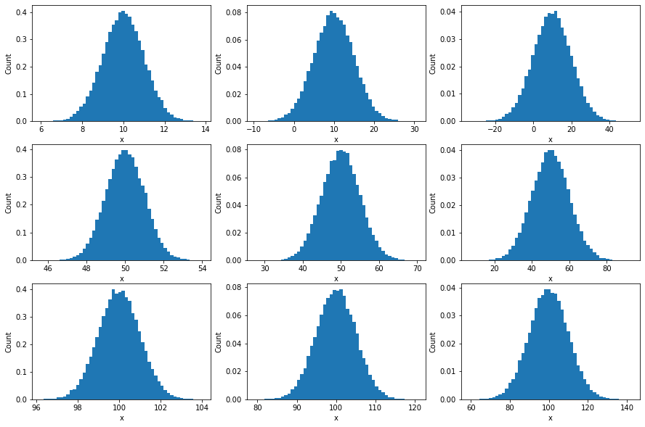
Hopefully what your homework shows
How does changing the mean or standard deviation of our hypothetical normal distribution effect our null t distribution?
Here, we show several normal distributions, developed using our previous code. If we apply our single sample t equation to generate a null distributions of t values when selecting 5 samples (n=5), we get the next slide
Standard Deviation
1
5
10
10
Mean
50
100

Slide 5
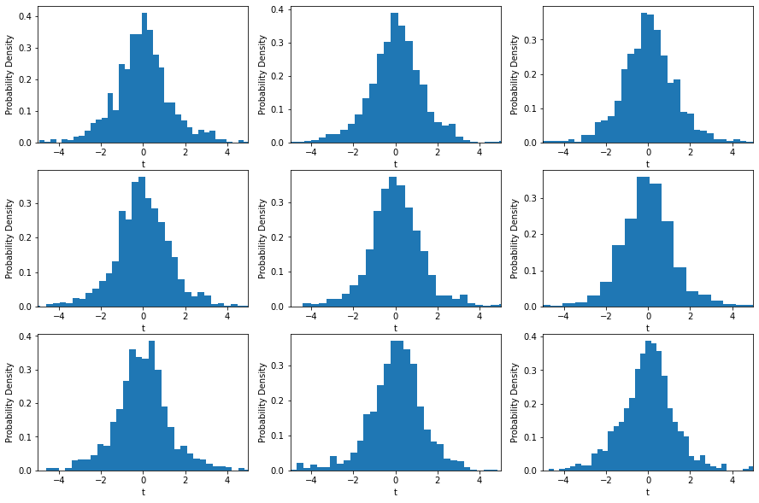
Hopefully what your homework shows
The mean and standard deviation of the null normal distribution DOES NOT EFFECT the null distribution of our t values!
Standard Deviation
1
5
10
10
Mean
50
100

Slide 6
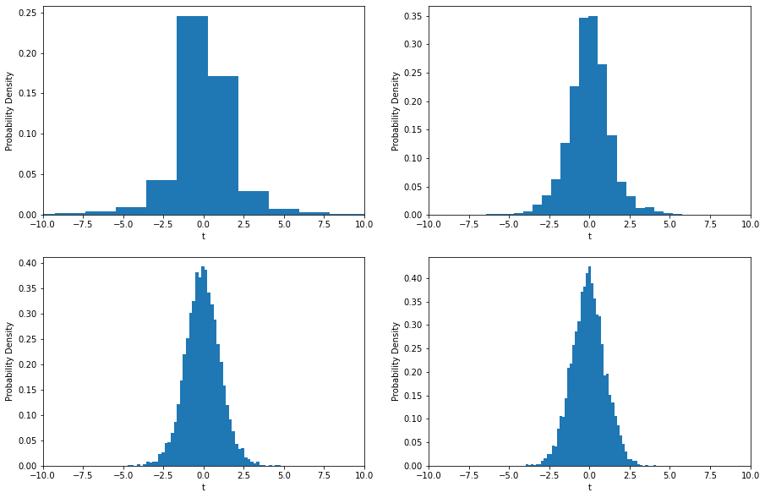
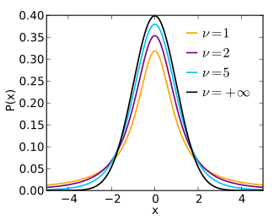
Hopefully what your homework shows
Changing n, our sample size does change our null t distributions.
n = 3
n = 5
n = 15
n = 30
This is why when you use a look up table for a t test, you have to look up the t value’s interpretation based on the degree of freedom, which is n-1

Slide 7
Degrees of Freedom are all we need to know
DF = n-p
n is your sample size
p is the number of parameters being estimated
For single sample t test, the DF is n -1
Once we know the DF, we can look up the t distribution in a table or make a t distribution by choosing the correct number of samples from ANY NORMAL DISTRIBUTION.

Slide 8
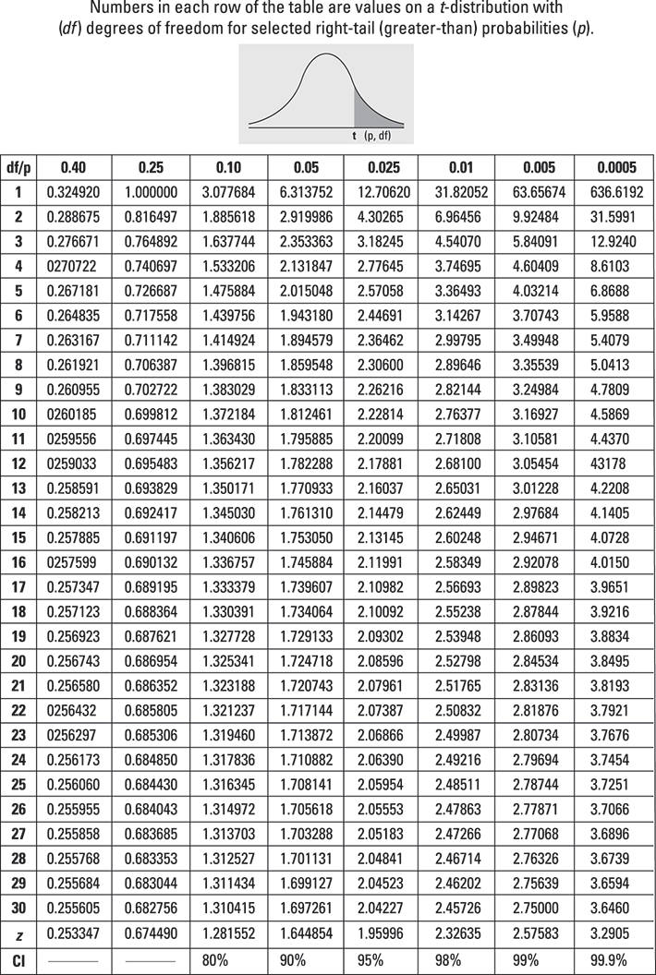
Note the table reports only 1 sided p values. If interested in the 2 sided p value, you must half the value of p
E.g. want t for when two-side p = 0.05. This corresponds to looking up t for p = 0.025 of the one-side p value.

Slide 9
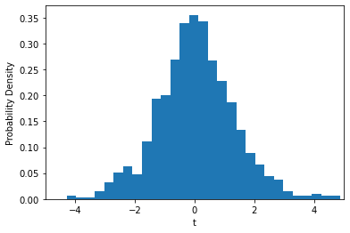
Summary of single sample t tests
A single sample t test tells us the likelihood of obtaining a specific value of t from n samples
The null distribution of t tells us the expected values of t that occur by random sampling and depends only on n
Once we calculate t for a specific sample, we find the significance of t in the same way we find the significance of Z or any other statistic.
Null Distribution of t for n = 5
By randomly sampling normal distributions of any mean and SD, we see that t is typically between -3.5 and 3.5.

Slide 10

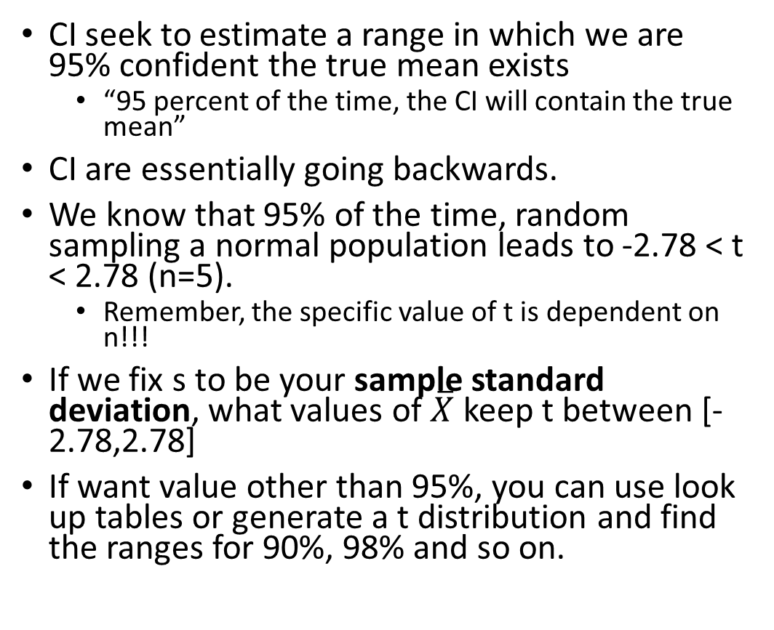
Confidence intervals
N = 5
DOF = 4
CI seek to estimate a range in which we are 95% confident the true mean exists
“95 percent of the time, the CI will contain the true mean”
CI are essentially going backwards.
We know that 95% of the time, random sampling a normal population leads to -2.78 < t < 2.78 (n=5).
Remember, the specific value of t is dependent on n!!!
If we fix s to be your sample standard deviation, what values of $\overline{X}$ keep t between [-2.78,2.78]
If want value other than 95%, you can use look up tables or generate a t distribution and find the ranges for 90%, 98% and so on.
tmp = c(23,45,32,45,32);
s = 9.5;
X_bar = 35.4
Set t based on our table

Slide 11
Two-sample t tests

Slide 12
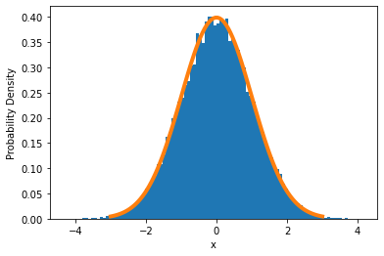
Be honest: you hate the idea of μ
Any Normally Distributed Data
Null Distribution of t for n = 5
For a single sample t test, you must assume a value for the population mean, μ.
Most people hate this idea and it is sometimes difficult to understand without an example. But remember, to say something is significant, you have to have something to compare against.
For single sample tests, you have to take the time to identify a reasonable μ. Randomly chosen values of μ will have no meaning

Slide 13
Be honest: you hate the idea of μ
Any Normally Distributed Data
Null Distribution of t for n = 5
For example, we suspect that LA Laker’s basketball players are taller than the average NBA player. So we can measure the height of 5 volunteer players to get a sample mean, but how do we get the population mean, μ?
You ask for stats from the NBA
Read literature on sports science
But don’t choose some random reference! A dumb guess will lead to a dumb answer.

Slide 14
Well – let’s avoid decision making and take 2 samples!
Very often we won’t have a reasonable guess for the population mean.
We can expand the idea of t to apply to two samples where we collect data from two populations we wish to compare
LA player heights vs Boston player heights
Inflammatory marker levels in mice infected or mock-infected
The foundation of the 2 sample t test is that we assume that the samples for both populations come from normal populations with the same means.
From there, we can add some variations. We can assume the standard deviations are the same for both samples or assume each sample has a unique standard deviation
We’ll only explore on type of two sample t test

Slide 15
Two sample t test
One thing to know about t distributions is that they only depend on the degrees of freedom
You’ll see this in your next homework
I.e. the null t distribution for a single sample t test with DF = 6 is the same for a two sample t test with DF = 6.
Two types of two sample t tests
Independent two-sample t test
tests to determine if two samples come from normal populations with equal means
Paired two sample t test
somehow, samples are related between the two groups (same set of people given two different tests)
a difference of means tests which test to see if the mean is if from a normal population with a mean of zero

Slide 16



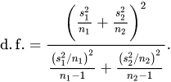


Two sample t test variations
Independ two sample, equal sample size and assumed equal variation
Independ two sample, equal sample size and assumed equal variation
Dependent paired two sample t te
DF = 2n - 2
Usually rounded off
DF = n-1 where n is the # of pairs
$\overline{X_{D}}$ and $s_{D}$ are the average and standard deviation of the differences between all pairs

Slide 17
T tests and linear regression
Before, we studied linear regression, in which we estimated the parameters of a linear model (y = mx +b) using linear least squares or gradient descent.
t tests are fully analogous to linear models, which is why a t statistic can be used to inform us about the significance of a parameter

Slide 18
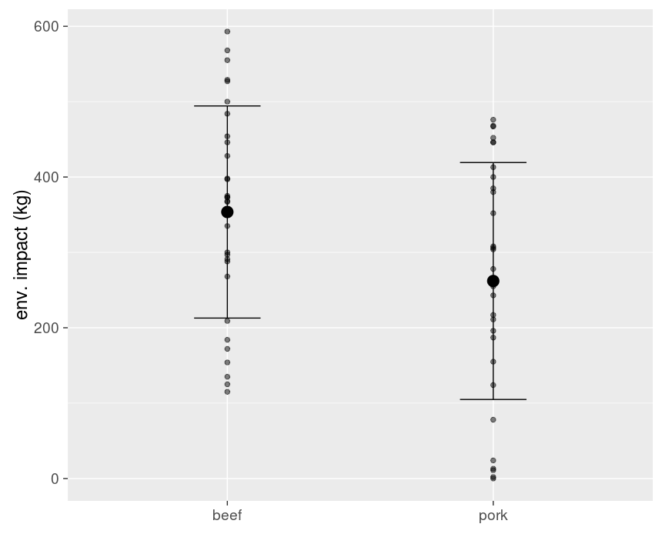
T tests and linear regression
Let’s look at fake data on the environmental impact of beef and pork
Two sample t tests determines if the means of two samples comes from the same normal distribution
We can relate the difference in means to a linear regression exercise
By plotting the data, we can convert the categorical variables (Beef, Pork) into a continuous variable (called a dummy variable) where Beef is at the zero position and Pork is at the 1 position
We can now apply linear regression to our data!
0
1
https://scientificallysound.org/2017/06/08/t-test-as-linear-models-r/

Slide 19
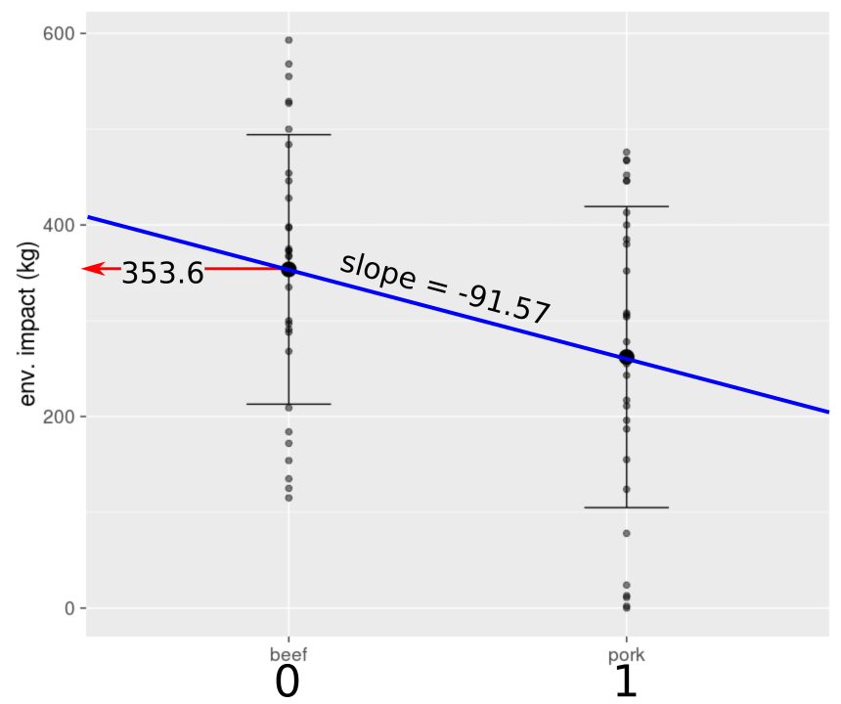
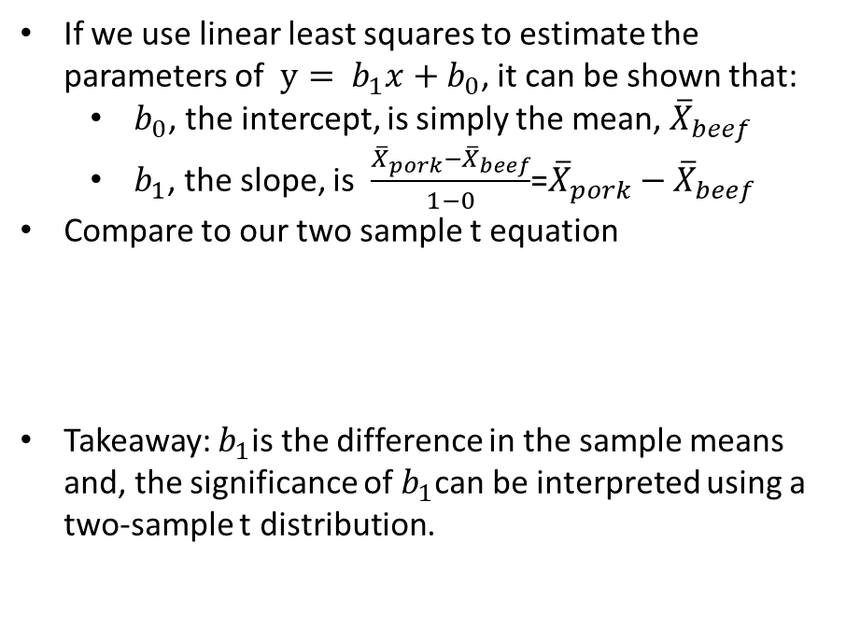
T tests and linear regression
If we use linear least squares to estimate the parameters of $y= b_{1}x+b_{0}$, it can be shown that:
$b_{0}$, the intercept, is simply the mean, ${\overline{X}}_{beef}$
$b_{1}$, the slope, is $\frac{{\overline{X}}_{pork}−{\overline{X}}_{beef}}{1−0}$=${\overline{X}}_{pork}−{\overline{X}}_{beef}$
Compare to our two sample t equation
Takeaway: $b_{1}$is the difference in the sample means and, the significance of $b_{1}$can be interpreted using a two-sample t distribution.
https://scientificallysound.org/2017/06/08/t-test-as-linear-models-r/

Slide 20
Takeaway
The parameter values estimated using linear least squares translate to either a mean (intercept) or a difference in means (slope)
And since we use a t test to determine the likelihood of observing a mean (single sample t test) or difference in means (two sample t test), we can use t tests to evaluate the significance of the estimated parameters.
This is why you will often see people use linear regression instead of t tests of visa versa – they are essentially the same thing.
For completeness, if there are only two groups, linear regression, t tests and ANOVA are all the same thing. They are all based on the same assumptions of linearity and normal distributions.
However, linear regression and ANOVA can be expanded to consider more than 3 groups. We unfortunately don’t have time to cover this
But to reiterate, linear regression and ANOVA tools ultimately do the same thing. But as both technique were developed independently, they use a different language to describe model construction

Slide 21
Example t test and linear regression in python
Back to our idea of comparing the heights of NBA players. We want to determine if the height of players for the Lakers and the Heat are the same. We randomly measure the height of 5 players.
Lakers = [200, 210, 220,225,215];
Heat = [190, 220, 193, 200, 190];
Use ttest_ind to perform a two-sample, independent t test. Report the t value and two-sided p value
To do a linear regression
Combine the heights into a single vector, y
Make a vector, x, that has a 1 or 0 to indicate if the corresponding data in y is a Laker (1) or Heat (0) player
# import statsmodels.api to fit a linear model between x and y using OLS function (a general function for fitting linear equations)

Slide 22
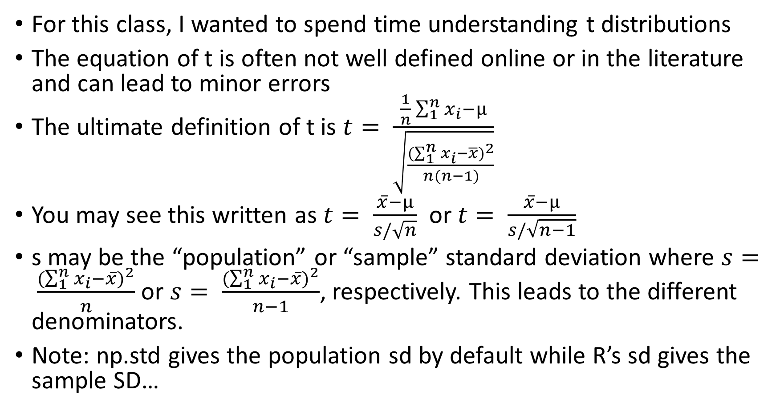
Technical note on t values
For this class, I wanted to spend time understanding t distributions
The equation of t is often not well defined online or in the literature and can lead to minor errors
The ultimate definition of t is $t= \frac{\frac{1}{n}\sum_{1}^{n}{x_{i}}−μ}{\sqrt{\frac{{(\sum_{1}^{n}{x_{i}}−\overline{x})}^{2}}{n(n−1)}}}$
You may see this written as $t= \frac{\overline{x}−μ}{s/\sqrt{n}}$ or $t= \frac{\overline{x}−μ}{s/\sqrt{n−1}}$
s may be the “population” or “sample” standard deviation where $s= \frac{{(\sum_{1}^{n}{x_{i}}−\overline{x})}^{2}}{n}$ or $s= \frac{{(\sum_{1}^{n}{x_{i}}−\overline{x})}^{2}}{n−1}$, respectively. This leads to the different denominators.
Note: np.std gives the population sd by default while R’s sd gives the sample SD…

